Slide 1
Travel Explorer
Pallavi Desai - 62
Neeraj Padarthi - 37
Harish Tata - 50
Saran Akkiraju - 2

Slide 2
OBJECTIVE
Main moto of this project is to provide a good itineary to the user within the budget and in specified duration given by the user.

Slide 3
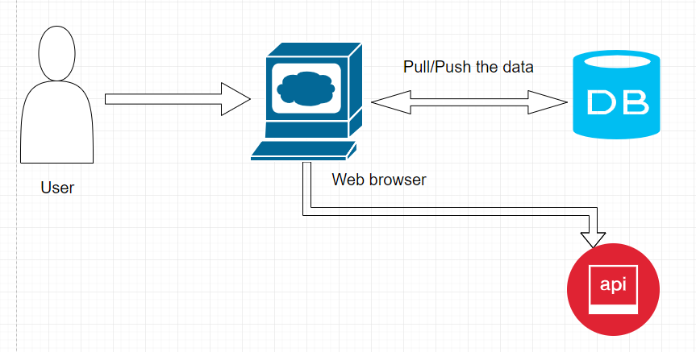
Architecture Diagram

Slide 4
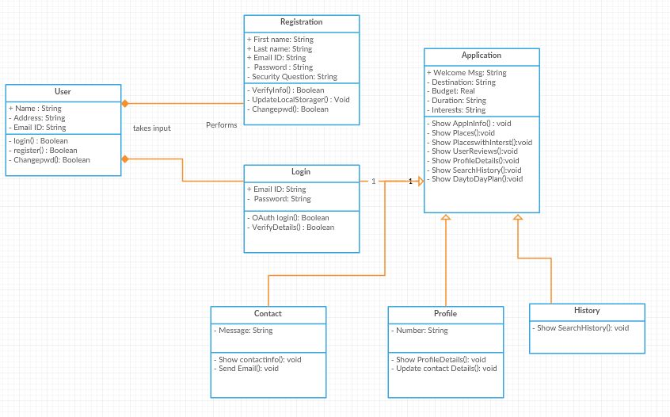
Class Diagram

Slide 5
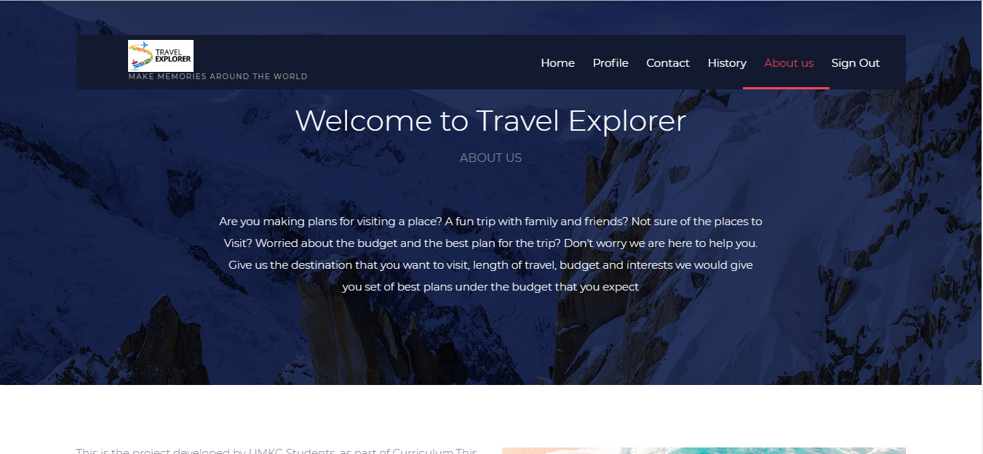

Slide 6
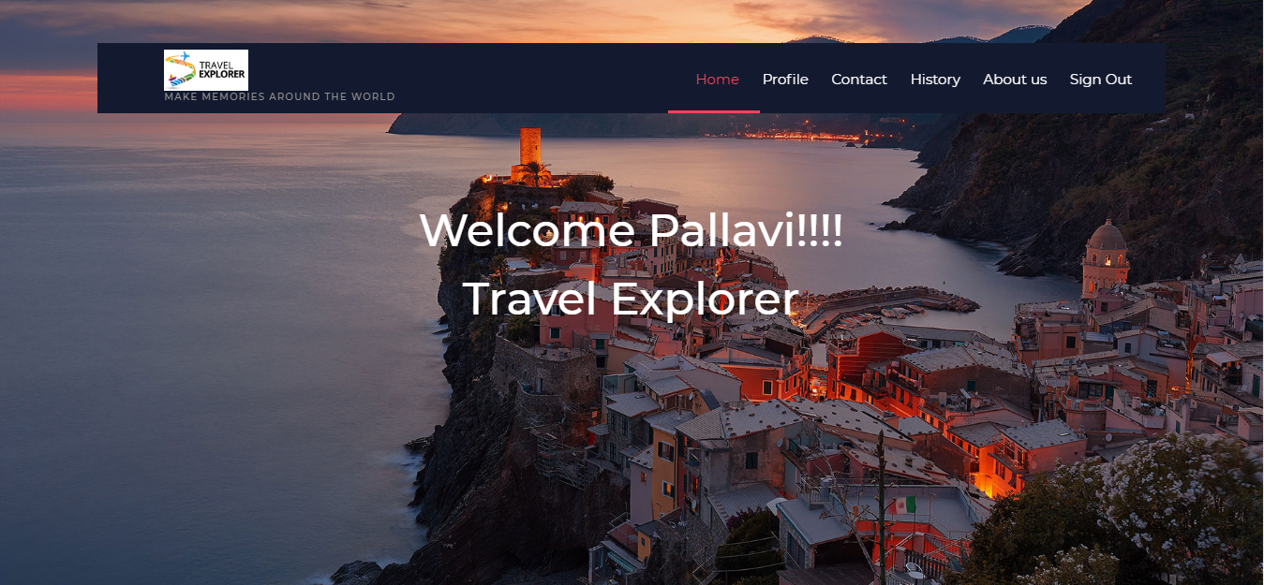

Slide 7
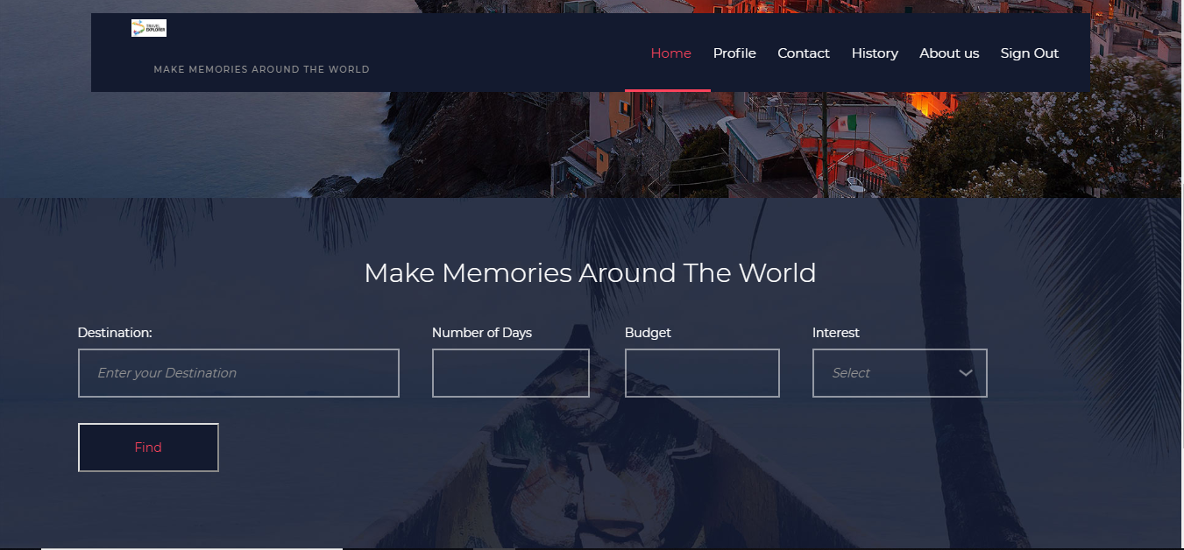

Slide 8
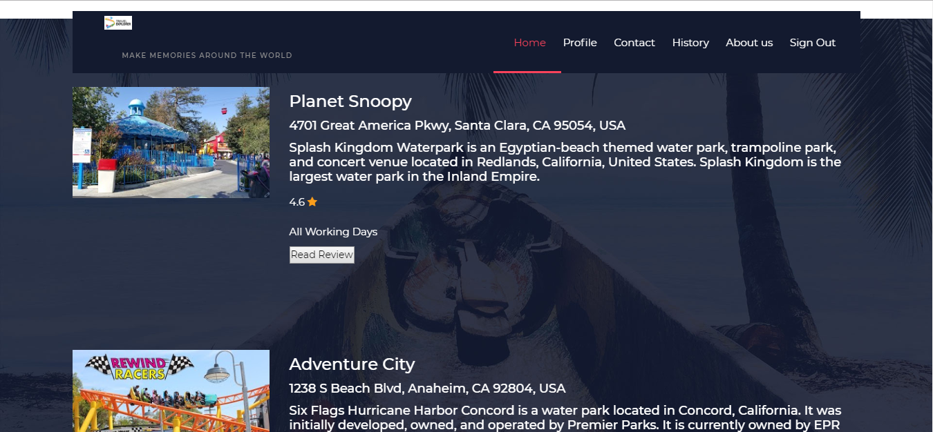

Slide 9
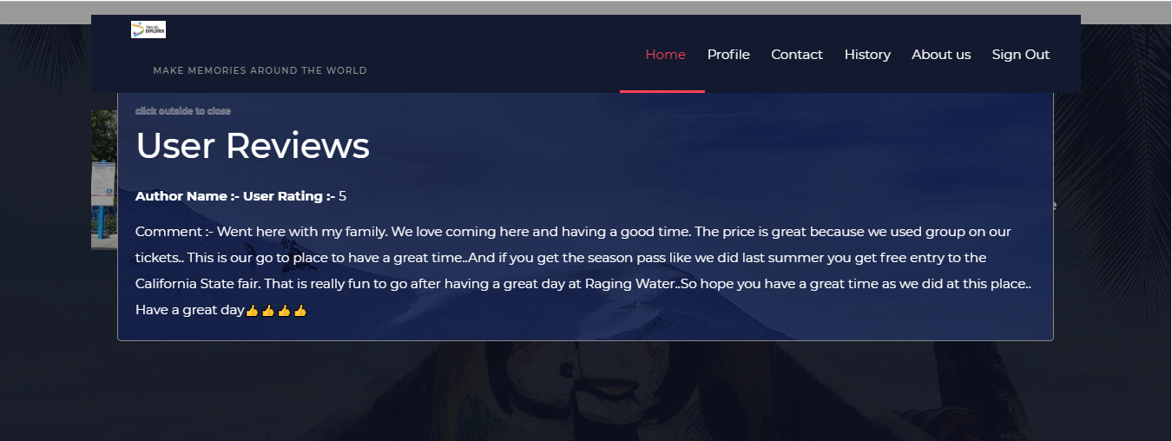

Slide 10
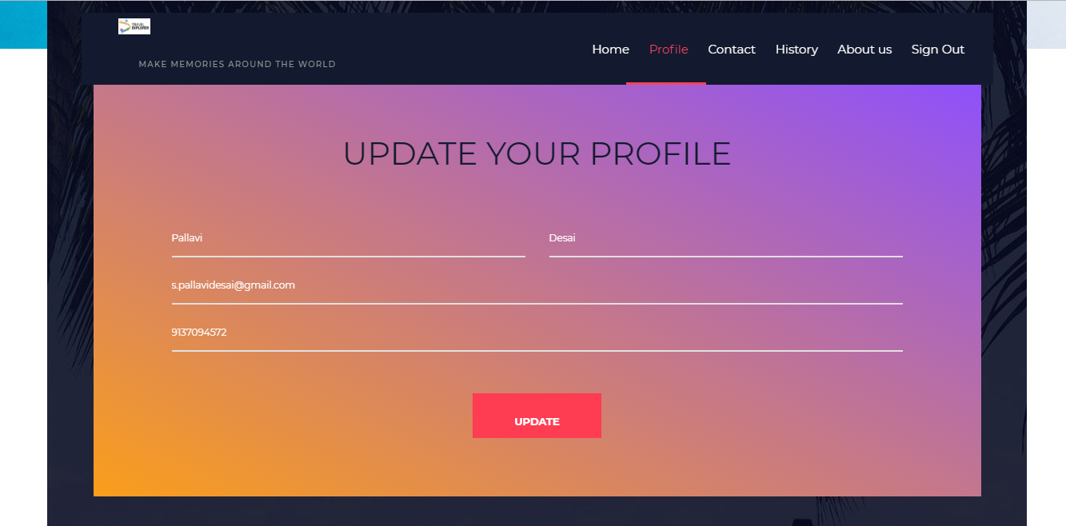

Slide 11
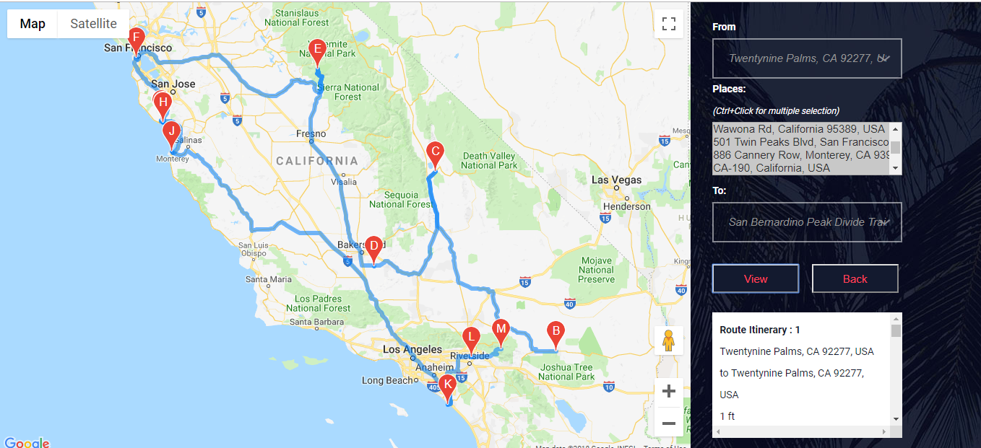

Slide 12
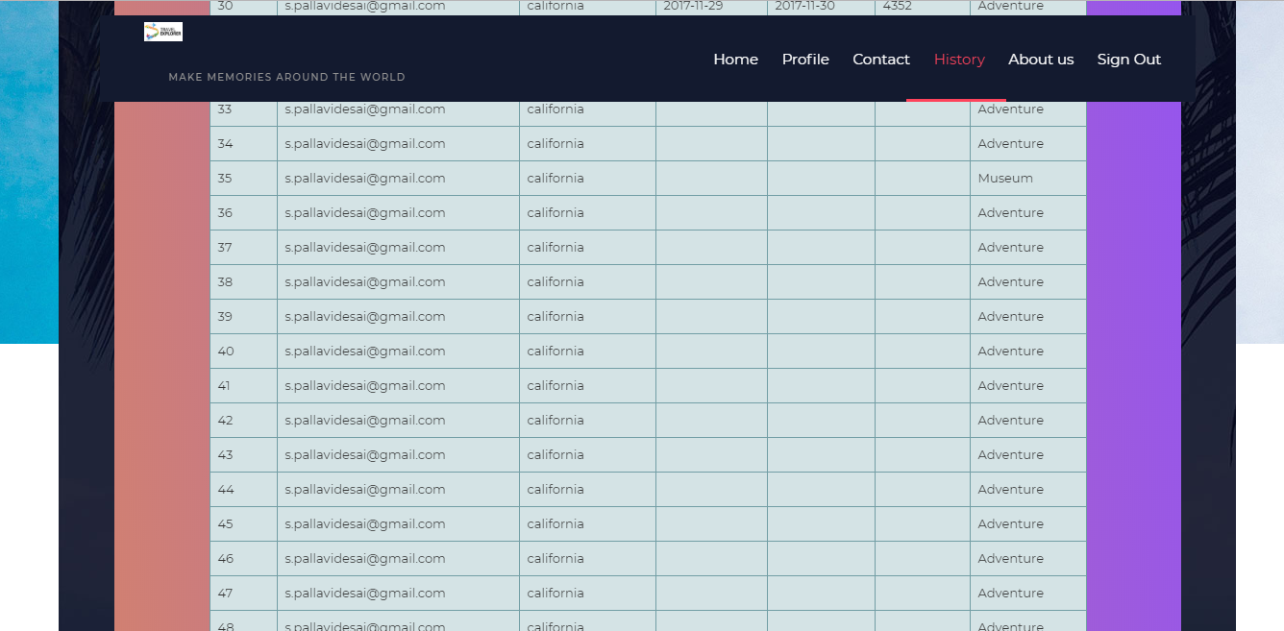

Slide 13
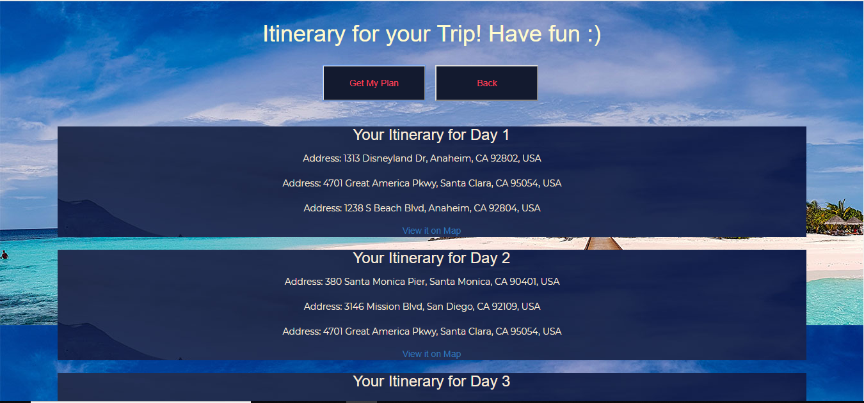

Slide 14
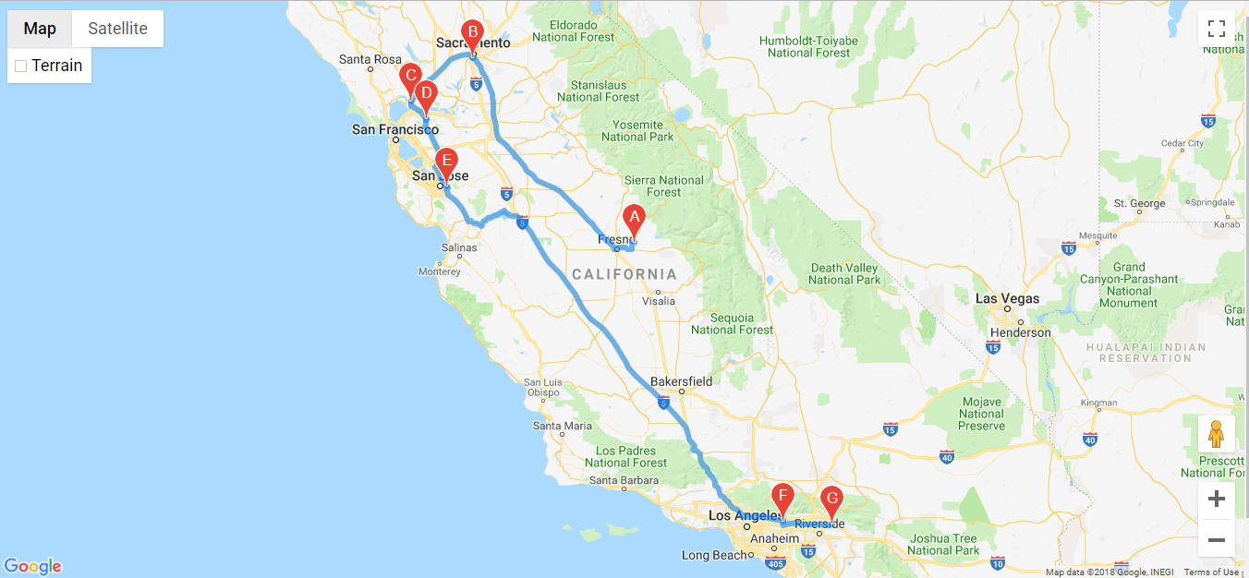

Slide 15
